Slide 1
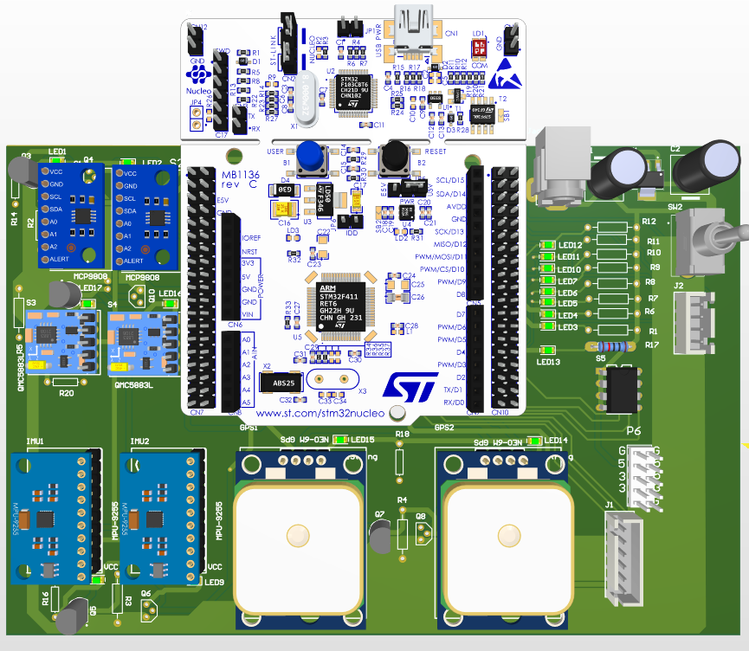
ADCS Sub-System

Slide 2

ADCS RESPONSIBILITIES
Altitude determination
Altitude Control
Microcontroller
Sensors
Actuators

Slide 3
HOW?
Functional description of the ADCS

Slide 4
1
Detection
How is the CubeSat is oriented?

Slide 5
Two Vectors
Vectors
Sun vector
Geomagnetic vector
The vector pointing to the sun
The vector of geomagnetic field

Slide 6
Two frames of reference
Frames
Local frame
Global frame
Any frame that is fixed to the CubeSat.
Any frame that fixed to the earth or the stars.

Slide 7
Rotation Matrix
Defines how one frame is oriented with respect to another frame
Translate one vector from frame to another frame
To find it we need two pairs of vectors
The rotation matrix is the output of the detection phase.

Slide 8

ADCS Sensors
Magnetometer
Sun sensor
GPS
IMU

Slide 9
Models
Our way to global vectors

Slide 10
Sun Vector Model
We can mathematically model the relative motion between sun and earth.
If we know time and date, we can calculate the sun vector in earth’s frame.
So, we give the time, it gives the global sun vector.

Slide 11
Geomagnetic Vector Model
We can mathematically model the geomagnetic field.
If we know time and position, we can calculate the geomagnetic vector in earth’s frame.
So, we give the time and position, it gives the global geomagnetic vector.

Slide 12
Position
Fairy tale of the good TLE and SGP

Slide 13
—Me and Newton
“
If you know your position and speed at the present, you can predict where you will be at the future.
”

Slide 14
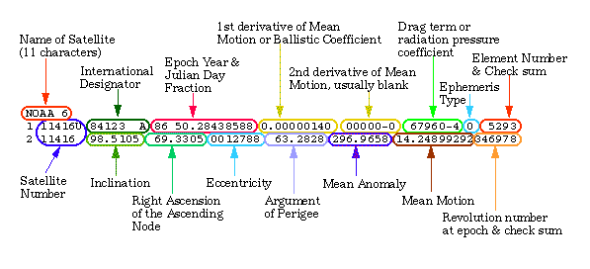
TLE Frame

Slide 15
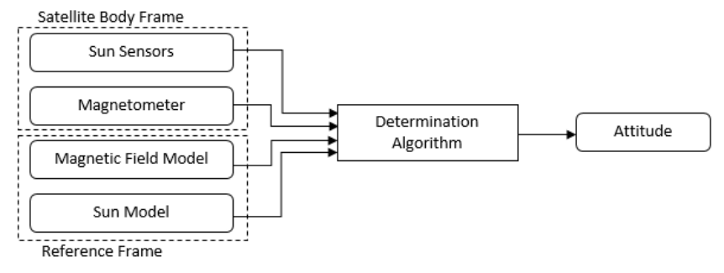
Altitude Determination

Slide 16
2
Control
How to make a difference?

Slide 17
Actuators
Actuators
Reaction wheel
Magnetic torquer

Slide 18
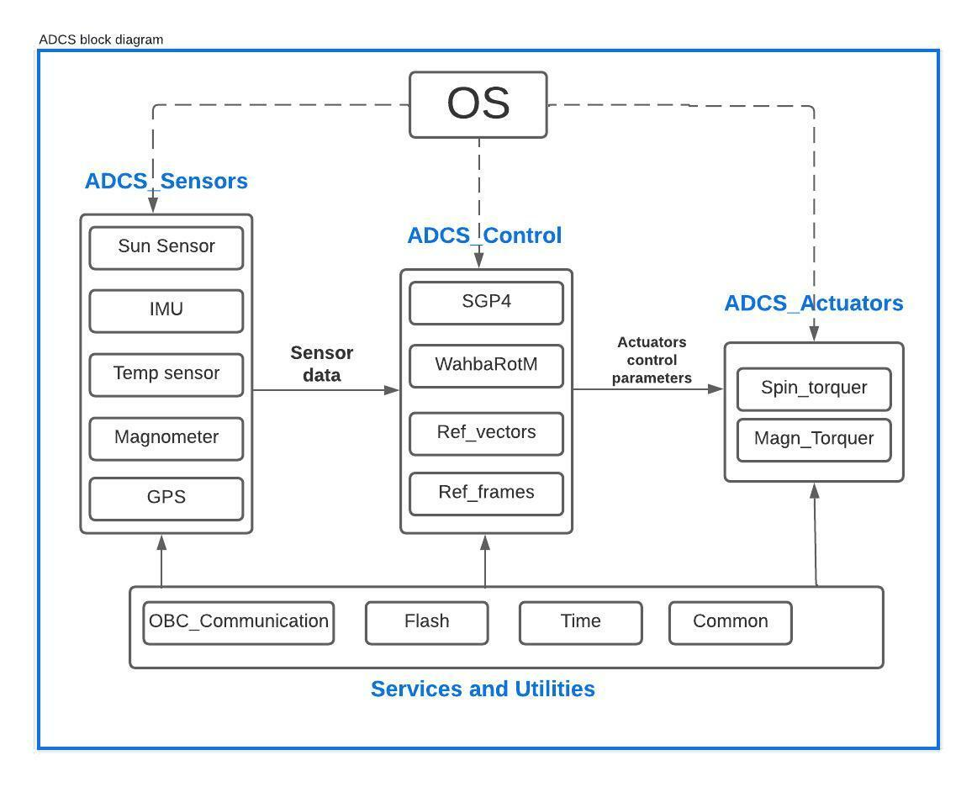
ADCS Static Design

Slide 19
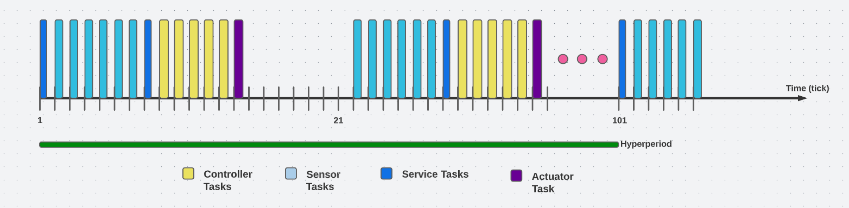
ADCS Dynamic Design

Slide 20
Further Work
Flight model
Mission subsystem
Improve hardware designs

